Slide 1

Computerized drive for permanent magnets in a spectroscopic setup
Project number: p-2022-048.
Students: Raam Kavod, Eylon Kapel.
Advisers: Dr. Ilan Shalish

Slide 2
Background
Challenges
In the future, we may not be able to solve any problem with Silicon, therefore the need to research alternative materials grows.
Certain material characterization methods require conditions of a magnetic field in a Faraday cage
To do research on such materials, there needs to be a system capable of providing all the needed tests conditions properly.
Project’s purpose
The purpose of this project is to enable remote computerized control of research materials’ measurements under conditions of a magnetic field in a Faraday cage.

Slide 3
Objectives of the planned system
Moving a magnet remotely according to user’s input
Feedback on what’s inside the “black box” via LEDs and taken measurements
Robust system such that it will not encounter issues and bugs throughout time used
Simple to use and understand

Slide 4
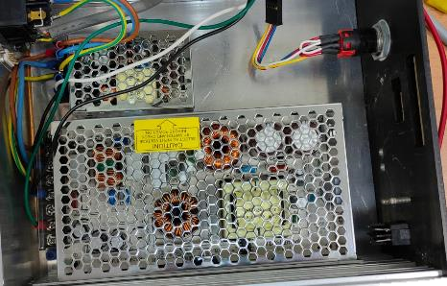
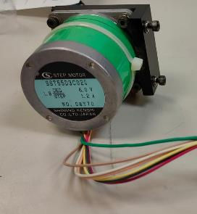
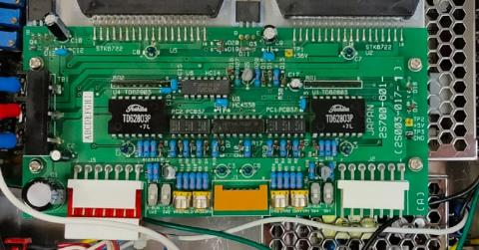
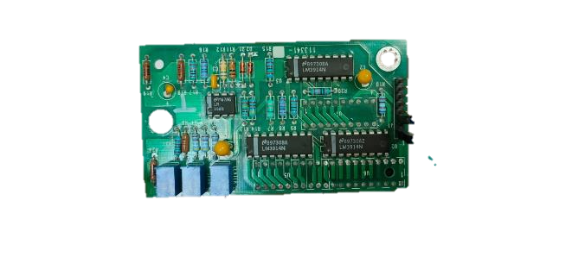
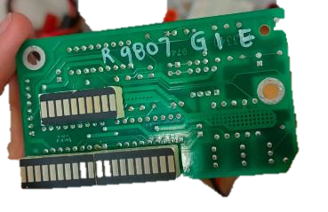
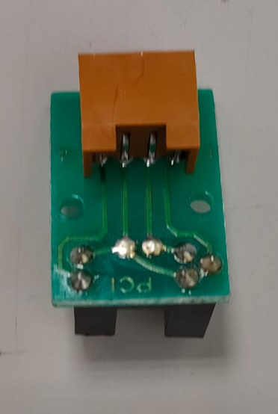
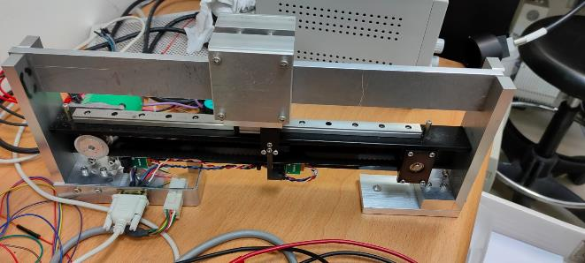
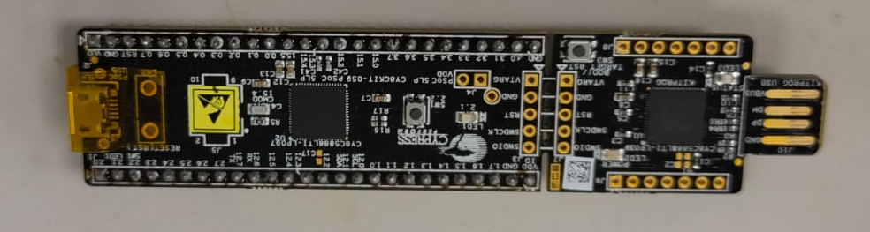
Project’s system – The essence of the system is built from the following parts:
Motor driver PCB circuit
Power supply
Stepper motor
LEDs
Optoelectrical
sensors
Magnet and conveyor belt
PSoC microprocessor

Slide 5
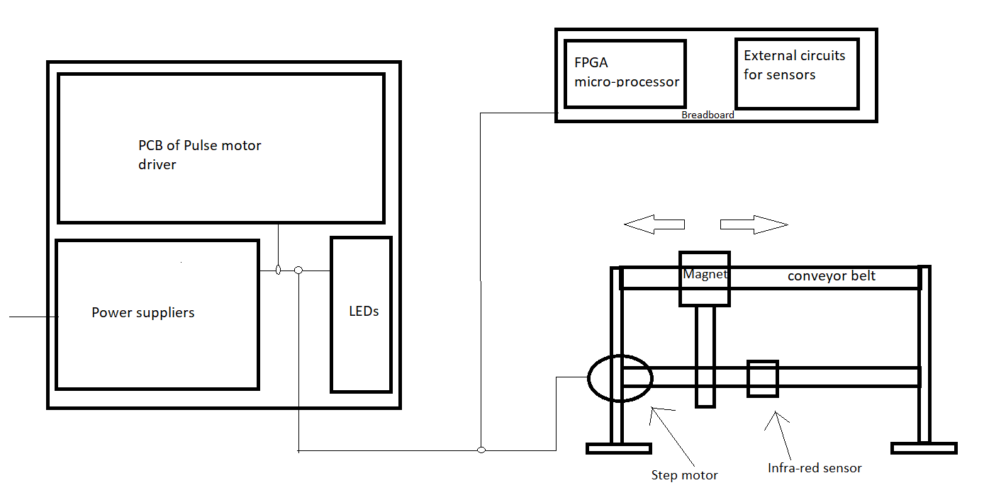
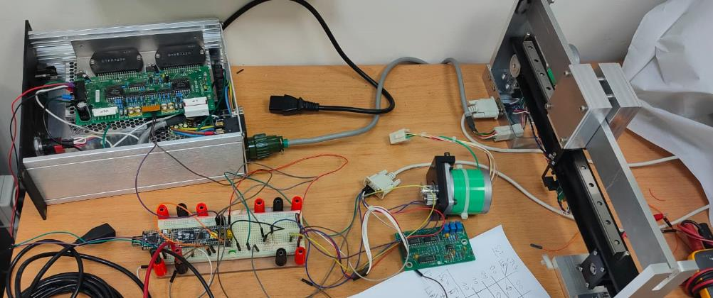
Complete system
Breadboard implementation
Schematic

Slide 6
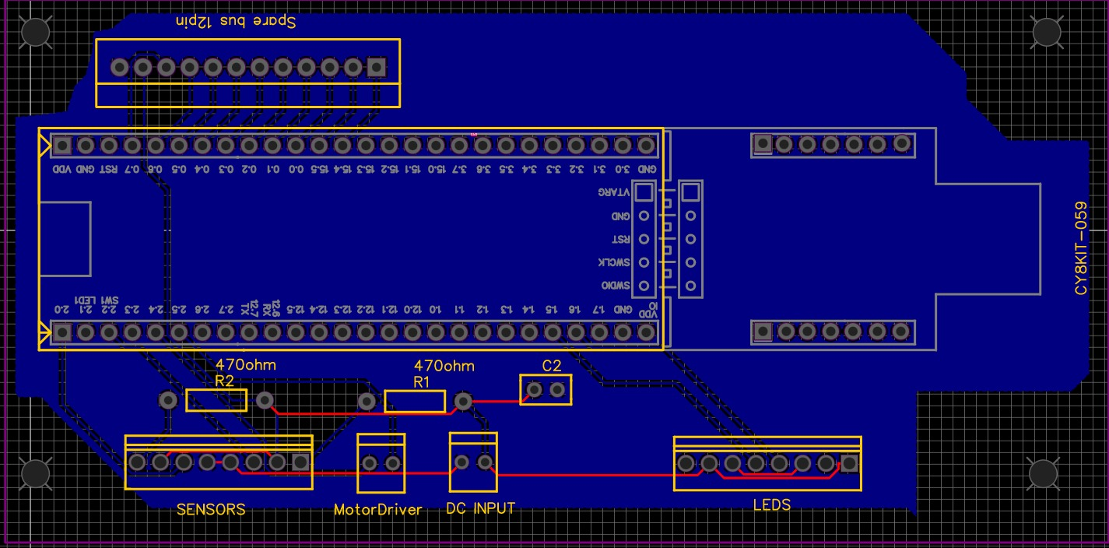
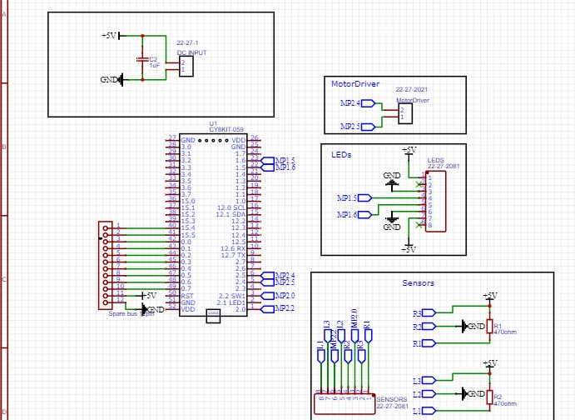
PCB design

Slide 7
Current results
Learned all different parts and integrated them together
Learned the FPGA microprocessor programs and wrote its state machine routine
Working system with breadboard implementation
Designed and printed the PCB

Slide 8
Problems
How to use the various parts to achieve the wanted results
When the magnet is moving, the system is under noise and physical disturbances
The microprocessor works with digital signals, but the system parts are mostly analog
How to design the PCB and what are the considerations needed to take in account

Slide 9
Solutions
Find the parts datasheets, study them with trial and error & divide and conquer methods
Changing the PWM duty cycle and frequency such that the speed and acceleration will have minimal disturbances by decreasing sudden changes and torque of stepper motor. we might also use shock absorbers
Learning and using D2A and A2D convertors of the FPGA
Studying PCB design tools and implementing general principals such as creating spare connections, adding a capacitor for AC signals filtering from power source, avoiding ground loop etc.

Slide 10
Conclusions and further objectives
Currently the project matches our initial expectations and plannings
Add connectors to the PCB and integrate the rest of the system with it
Place the system inside a black box and connect it to the LABVIEW program to provide input and enable measurements sampling
Run tests to see that the system works as planned in all cases without errors

